Slide 1


High Performance Cluster Computing
Architectures and Systems
Hai Jin
Internet and Cluster Computing Center

Slide 2
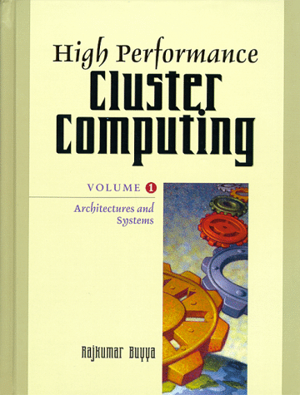
Parallel I/O for Clusters:
Methodologies and Systems
Introduction
A Case for Cluster I/O Systems
The Parallel I/O Problem
File Abstraction
Methods and Techniques
Architectures and Systems
The ViPIOS Approach
Conclusions and Future Trends

Slide 3
Introduction (I)
Microprocessors increase their performance by 50% to 100% per year, but disk hardly their performance
  This problem is more exaggerated in processing huge data sets
    smart parallel I/O algorithms are required to access the data on disk efficiently
In high performance computing the application shifted from being CPU-bound to be I/O bound
Performance cannot be scaled up by increasing the number of CPUs any more, but by increasing the bandwidth of the I/O subsystem

Slide 4
Introduction (II)
Cluster-based parallel I/O systems
ViPIOS
  client-server based tool
    combining capabilities found in parallel I/O runtime libraries and parallel file systems

Slide 5
A Case for Cluster I/O Systems (I)
An architectural framework similar to a cluster of computers can be found in state-of-the-art MPP systems
Two different types of I/O systems for MPPs
  external attached I/O subsystems
    connected with the MPP by a separate interconnection bus
    dedicated bus
    system administration and application development are relatively simple
  internal I/O nodes
    an I/O node is a conventional processing node with a disk attached
    only the software distinguishes between I/O and computing node

Slide 6
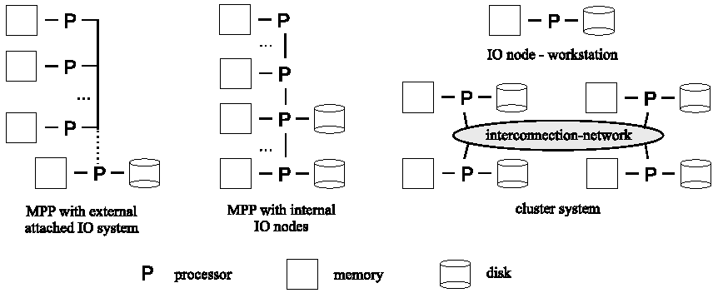
I/O Architecture Topologies

Slide 7
A Case for Cluster I/O Systems (II)
MPP I/O framework is similar to cluster I/O framework
Eminent drawback is the latency of the interconnection network
  Computational-bound application
    It is overcome by applying new bus technologies (Giganet, Myrinet) or by using multiple I/O buses in parallel
  I/O based application
The already developed methods and paradigms to overcome this I/O bottleneck on MPP systems can similarly be used on cluster system
  Clusters are a suitable platform for I/O based applications

Slide 8
The Parallel I/O Problem (I)
IO needs of typical supercomputing applications
  Input
  Debugging
  Scratch file
  Checkpoint/restart
  Output
  Accessing out-of-core structure
Regular Problem
  This approach is supported by the well-known SPMD model
    Single thread control-parallel execution
    Global namespace
    Loose synchronization
  This model design a sequential program and transfer it to parallel execution

Slide 9
The Parallel I/O Problem (II)
Irregular Problem
  Data access patterns cannot be predicted until runtime
  Three different kinds to be optimized
    Irregular control structures
      conditional statements making it inefficient to run on synchronous programming models
    Irregular data structures
      unbalanced trees or graphs
    Irregular communication patterns
      these lead to non-determinism
Out of Core (OOC) Computation
  Primary data structure do not wholly fit into main memory
  Computation is carried out in several phases
    Data is brought into main memory
    Process
    Store back onto secondary storage

Slide 10
File Abstraction (I)
Files can be accessed synchronized
  By collective file operations
4 execution modes for parallel file I/O
  Broadcast-reduce
    access the same data collectively
    for a read, all processes get a copy of the read data
    for a write, data is written only once
  Scatter-gather
    all processes access different parts of the file
  Shared offset
    the processes share a common file handle but access the file individually
  Independent
    each process has its own private handle

Slide 11
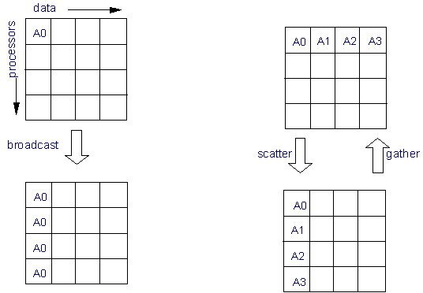
Collective Communication in MPI (I)

Slide 12
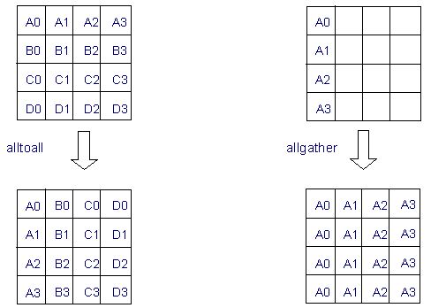
Collective Communication in MPI (II)

Slide 13
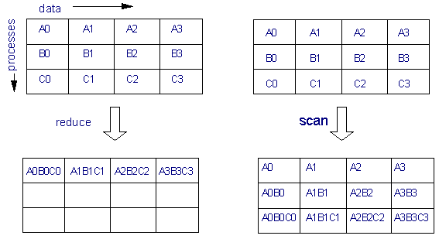
Collective Computation in MPI

Slide 14
File Abstraction (II)
Layers in the file architecture to allow flexibility for the programmer and the administration methods
Three independent layers in the file architecture
  Problem layer
    Define problem specific data distribution among cooperating parallel processes
  File layer
    Provide a composed view of persistently stored data in the system
  Data layer
    Define physical data distribution among the available disks

Slide 15
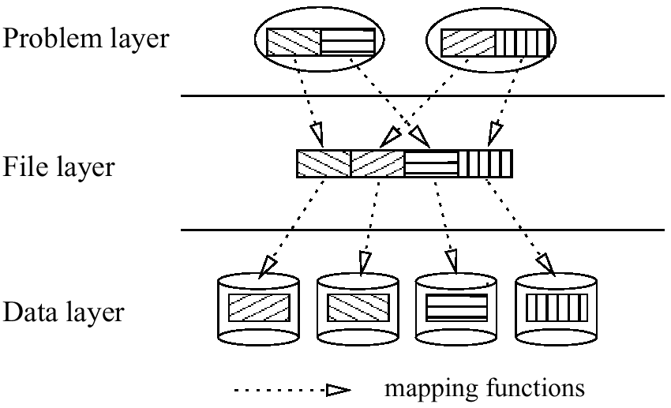
File Abstraction

Slide 16
File Abstraction (III)
Mapping functions between these layers
  Logical data independence
    exist between the problem and the file layer
  Physical data independence
    exist between the file and data layer

Slide 17
Methods and Techniques (I)
Aim to accomplish followings
  Maximize the use of available parallel I/O device to increase the bandwidth
  Minimize the number of disk read and write operation per device
  Minimize the number of I/O specific messages between processes to avoid unnecessary costly communication
  Maximize hit ratio (ratio between accessed data to requested data): data sieving

Slide 18
Methods and Techniques (II)
Three groups of methods in the parallel I/O execution framework
  Application level methods
    Try to organize the main memory objects mapping the disk space to make disk accesses efficient
      Buffering algorithm
    By runtime libraries which are linked to the application programs
    The application program performs the data accesses itself without the need for dedicated I/O server programs
  I/O level methods
    Try to reorganize the disk access requests of the application programs to achieve better performance
    By independent I/O node servers which collect the requests and perform the accesses
  Access anticipation methods
    Anticipate data access patterns which are drawn by hints from the code advance to its execution

Slide 19
Two Phase Method (TPM)
A method for reading/writing in-core arrays from/to disk
Base on the fact that I/O performance is better when process make an small number of large request instead of a large number of small ones
  The processes read data from disk
  Data is redistributed among the processes by inter-process communication
ETPM
  Several I/O requests are combined into fewer larger requests
    eliminate multiple disk accesses for the same data (reducing contention for disks)
  All processes have to participate in the collective operation
    Advantage: process can cooperate to perform certain optimizations when the same data is required by more processes

Slide 20
Disk Directed I/O
Improve the performance of reading/writing large, regular data structures such as a matrix distributed between memory and distributed disks
In traditional Unix-like parallel filesystems, individual processor make a request to the file system for each piece of data
  If many processes request the same data, a file is read multiple times and the data is transmitted to each processor independently
Interface that support collective I/O
  all processes make a single joint request to the file system
  optimizing data transfer
High-level request is sent to an I/O node
  usage of less memory, less CPU and message passing overhead
Double-buffering
Special remote-memory “get” and “put” message
  to pipeline the transfer of data

Slide 21
Two-Phase Data Administration (I)
Try to anticipate data access patterns of the application program as early as possible in the program execution cycle
Management of data is split into two distinct phases
  Preparation phase
    data layout decisions, data distribution operations
    precedes the execution of the application processes
    uses the information collected during the application program compilation process
    physical data layout schemes are defined
    actual server process for each application process and disks for the stored data are chosen
    data storage areas are prepared
    main memory buffers allocated
  Administration phase
    data accesses and data prefetching
    accomplishes the I/O requests of the application processes and performs necessary reorganization of the data layout

Slide 22
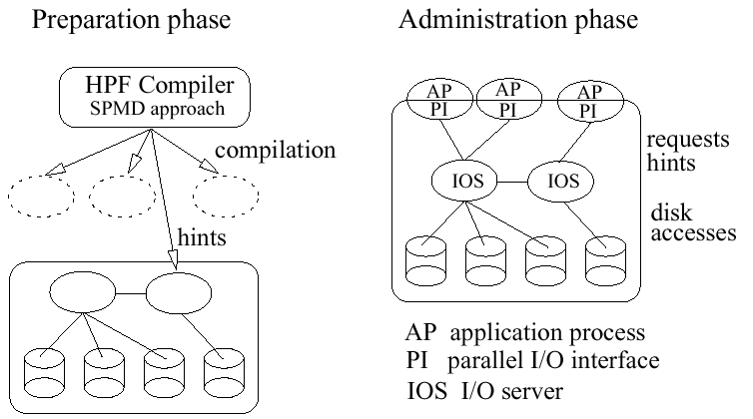
Two-Phase Data Administration

Slide 23
Two-Phase Data Administration (II)
Hints are the general tool to support the I/O subsystem with information for the data administration process
  Hints: data and problem-specific information provided by the application programmer or compiler
  File administration hints
    provide information on the problem specific data distribution of the application processes
    high parallelization can be reached if the problem specific data distribution of the application processes matches the physical data layout on disk
  Data prefetching hints
    yield better performance by pipelined parallelism and file alignment
  Administration hints
    allow the configuration of the I/O subsystem according to the problem situation respective to the underlying hardware characteristics and their specific I/O needs

Slide 24
Architectures and Systems
To solve I/O bottleneck problem
Two different approaches
  Parallel file systems
    low level solution
    OS is enhanced by special features that deal directly with I/O at the level of files
  Runtime library for high performance language
    enhance conventional high performance language such as Fortran or C/C++

Slide 25
Runtime Modules and Libraries
The aim is to adapt graciously to the requirements of the problem characteristics specified in the application program and tools for the application programmer
The executing application can hardly react dynamically to changing system situations or problem characteristics
  the data decisions were made during the programming and not during the execution phase
The CPU of a node has to accomplish both the application processing and the I/O request of the application
The optimal performance is nearly impossible to reach by the usage of runtime libraries

Slide 26
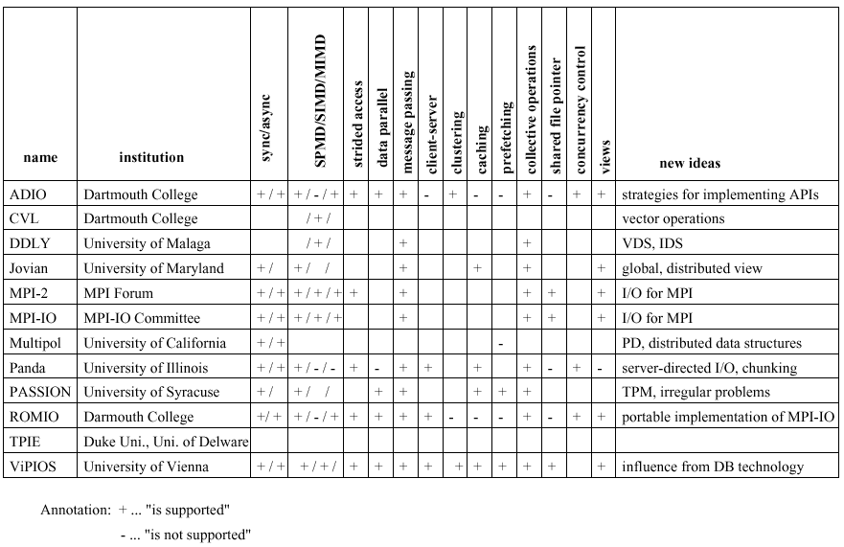
I/O Runtime Libraries

Slide 27
MPI-I/O
Parallel I/O interface based on MPI message passing framework
Supports a high-level interface
  partition files among multiple processes
  transfer global data structures between process memories and files
  optimizations of physical file layout on storage device
Three access functions
  Positioning is accomplished by explicit offsets, individual file pointers, and shared file pointers
  Synchronization and asynchronization (blocking, nonblocking, respectively)
  Coordination by collective operations
Typical implementation of MPI-IO
  PMPIO: Portable MPI I/O by NASA Ames Research Center
  ROMIO: as MPI-IO extension of MPICH by Argonne National Lab.
  MPI-IO/PIOFS: by IBM Watson Research Center
  HPSS implementation: by Lawrence Livermore National Lab.

Slide 28
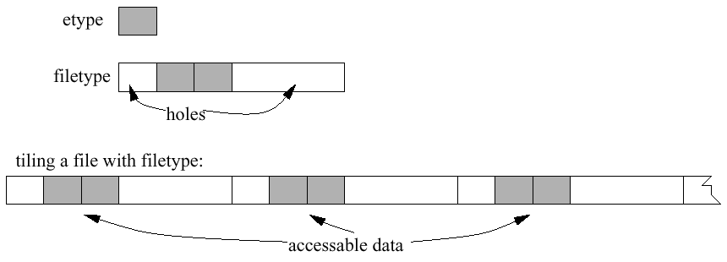
Tiling a File Using a Filetype

Slide 29
Parallel File Systems
Parallel disk access via a parallel filesystem interface
Balance the parallel processing capabilities of their processor architectures with the I/O capabilities of a parallel I/O subsystem
Compared to runtime libraries, parallel filesystems have the advantage that they execute independently from their application
  Execute independently from their application
  I/O servers are directly support
  Debugging
  Tracing
  Checkpointing
Drawback
  not support the capabilities of the available high performance languages directly
  disallow the programmer to coordinate the disk access according to the distribution profile of the problem specification

Slide 30
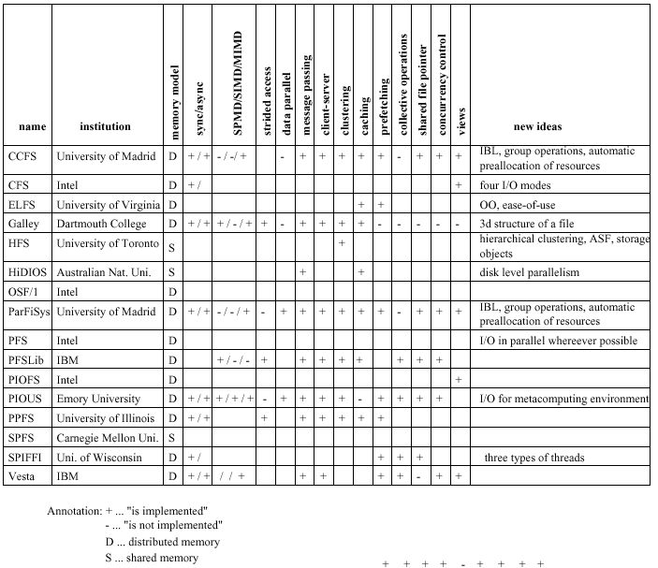
Parallel File Systems

Slide 31
Parallel Database Systems
Link to the spread of the relational model as the common user interface
Relational queries are well suited for parallel execution
Two different types of parallelism can be distinguished
  Inter-operator parallelism
    Parallelism from independent, but simultaneous, execution of different operators of the query execution tree
  Intra-operator parallelism
    Partitioning input data stream of one operator to a number of parallel query processes
    Each process execute the same operation on a different part of data

Slide 32
The ViPIOS Approach
By the University of Vienna
A full-fledged parallel I/O runtime system
Available both as runtime library and as I/O server configuration
  It can serve as I/O module for high performance languages and supports the standardized MPI-IO interface
It was developed by focusing on workstation cluster system
Parallel I/O for High Performance Languages
  Static fit property: adapt disk access profile of programmer or compiler
  Dynamic fit property: adaptability of the I/O runtime subsystem to applications or environment’s characteristics

Slide 33
Design Principles (I)
Gather all available information on the application process both during the compilation process and runtime execution
  Provide the optimal fitting data access profile for the application and may then react to the execution behavior dynamically
  Allow optimal performance by aiming for maximum I/O bandwidth
ViPIOS is an I/O runtime system which provides efficient access to persistent files
  by optimizing the data layout on the disks and allowing parallel read/write operations

Slide 34
Design Principles (II)
ViPIOS is supporting I/O module for high performance languages
Design principles
  Scalability
    System architecture is highly distributed and decentralized
  Efficiency
    Suitable data organization to provide a transparent view of the stored data on disk to the outside world
    Organize data layout on disk respective to the static application problem description and dynamic runtime requirements
  Parallelism
    Perform various forms of efficient and parallel data access modes

Slide 35
System Architecture (I)
The basic idea to solve the I/O bottleneck in ViPIOS is decoupling
  Disk access operations are de-coupled from the application and performed by an independent I/O subsystems
  Build upon a set of cooperating server processes
  Server processes run independently on all or a number of dedicated processing nodes on the underlying MPP
  One-to-many relationship between the application and the servers

Slide 36
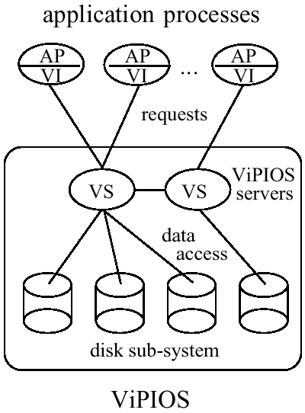
ViPIOS System Architecture

Slide 37
System Architecture (II)
Data Locality
  It is design principle to achieve high data access performance
  The data requested by an application process should be read/written from to the best-suited disk
  Logical Data Locality
    Choose the best suited ViPIOS server for an application process
  Physical Data Locality
    Determine the disk set providing the best data access

Slide 38
System Architecture (III)
ViPIOS Server
  Interface layer
    provide the connection to the outside world
  Kernel layer
    responsible for all server specific tasks
    Message manager is responsible for communication externally and internally
    Fragmenter makes decisions on the effective data layout, administration, and ViPIOS actions
    Directory manager stores the meta information of the data
    Memory manager is responsible for prefetching, caching and buffer management
  Disk manager layer
    provide the access to the available and supported disk sub-systems

Slide 39
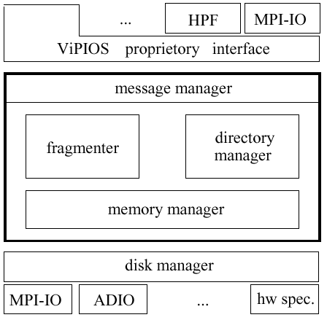
ViPIOS Server Architecture

Slide 40
System Architecture (IV)
System Modes
  Runtime library
    perform all disk I/O requests of the program
    ViPIOS is not running on independent servers, but as part of the application
  Dependent system
    ViPIOS is running as an independent module in parallel to the application, but is started together with the application
  Independent system
    achieve highest possible I/O bandwidth by exploiting all available data administration possibilities
    ViPIOS is running similar to a parallel filesystem or a database server waiting to connect via ViPIOS interface

Slide 41
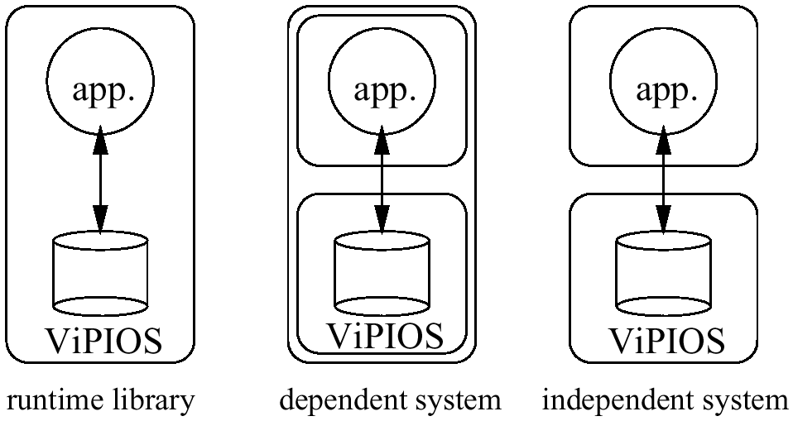
ViPIOS System Modes

Slide 42
Data Administration (I)
The data administration in ViPIOS is guided by two principles
  Two phase data administration
  Data access modes
Data access modes
  Local data access (buddy access)
    the buddy server can resolve the applications requests on its own disks
  Remote data access (foe access)
    the buddy server cannot resolve the request on its disks and must broadcast the request to the other ViPIOS servers to find the owner of the data

Slide 43
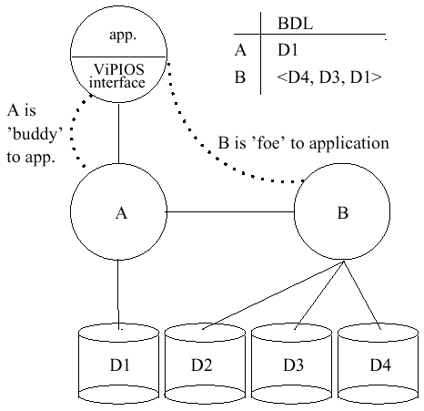
“Buddy” and “Foe” Servers
2

Slide 44
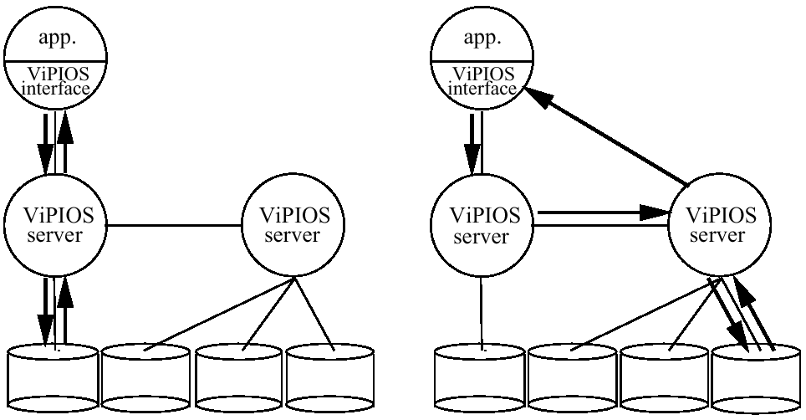
Local versus Remote Data Access

Slide 45
Data Administration (II)
Disk access modes
  Sequential mode
    allow a single application process to send a sequential read/write operation, which is processed by a single ViPIOS server in sequential manner
  Parallel mode
    ViPIOS processes the sequential process in parallel by splitting the operation into independent sub-operations and distributing them onto available ViPIOS server processes
  Coordinated mode
    a read/write operation is requested by a number of application processes collectively
    sub-operations are processed by ViPIOS servers sequentially

Slide 46
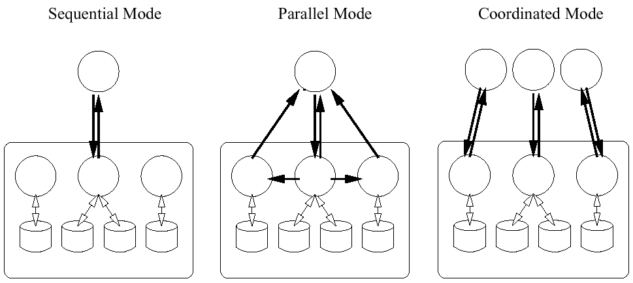
Disk Access Modes

Slide 47
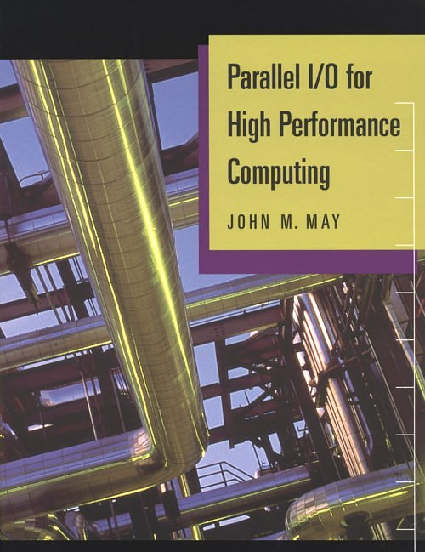
Reference Book

